Slide 1
Healthy Workplaces Campaign 2023-25
Safe and healthy work in the digital age
Ensuring effective prevention in the digital world of work

Slide 2

Overview
What is it about?
Facts and figures
Campaign objectives
Priority areas
Risk prevention
EU-OSHA and campaign partners
Campaign tools and resources
How to get involved

Slide 3
What is it about?
Digital technologies are rapidly changing how, where and when we work
For workers and employers in all sectors, digital technology offers increased opportunities but also presents challenges and risks in terms of safety and health

Slide 4
Facts and figures – use of digital technologies
EU-OSHA, OSH Pulse 2022
  EU workers at work use...
  Laptops, tablets, smartphones (73%)
  Wearable devices (11%)
  Machines or robots incorporating AI (5%)
  Robots interacting with the worker (3%)
EU-OSHA, ESENER 2019
  Over 80% of workplaces across Europe use personal computers, laptops, tablets, smartphones and other mobile devices
Notes:
Source: EU-OSHA, ‘OSH Pulse – Occupational safety and health in post-pandemic workplaces’, 2022 (https://osha.europa.eu/en/facts-and-figures/osh-pulse-occupational-safety-and-health-post-pandemic-workplaces).
Source: EU-OSHA, ‘Third European Survey of Enterprises on New and Emerging Risks’ (ESENER 3), 2019. Available at: https://osha.europa.eu/en/publications/home-based-teleworking-and-preventive-occupational-safety-and-health-measures-european-workplaces-evidence-esener-3

Slide 5
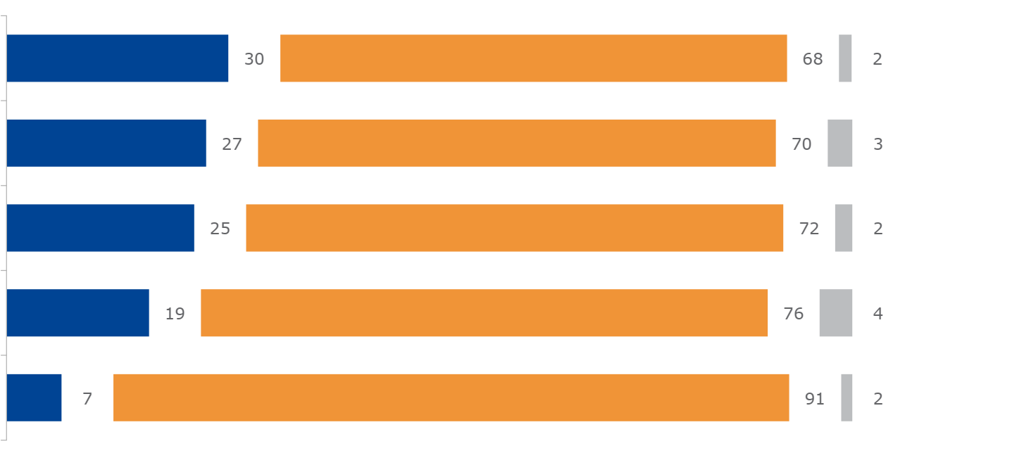
Facts and figures – use of digital technologies
EU-OSHA, OSH Pulse 2022
To your knowledge, does the organisation where you work use digital devices such as a tablet, smartphone, computer, laptop, app or sensor to… ?
Yes
No
Don’t know
Automatically allocate tasks or working time or shifts to you
Have your performance rated by third parties (e.g. customers)
Supervise or monitor the work and behaviour of you personally
Monitor noise, chemicals, dust, gases, etc. in your work environment
Monitor heart rate, blood pressure, posture, etc. of you personally
Base: all respondents, EU27 (n=25 683)
Notes:
Source: EU-OSHA, ‘OSH Pulse – Occupational safety and health in post-pandemic workplaces’, 2022 (https://osha.europa.eu/en/facts-and-figures/osh-pulse-occupational-safety-and-health-post-pandemic-workplaces).
EU-OSHA commissioned the ‘Flash Eurobarometer – OSH Pulse’ survey with the aim of gaining insights into the state of occupational safety and health (OSH) in post-pandemic workplaces.
A representative sample of more than 27,000 employed workers were interviewed in April and May 2022 in all EU countries, plus Iceland and Norway. They were asked about the mental and physical health stresses they face and the importance of OSH measures in their workplace.
The survey also asked about the work-related use of digital technologies and its impact on workers’ wellbeing.

Slide 6
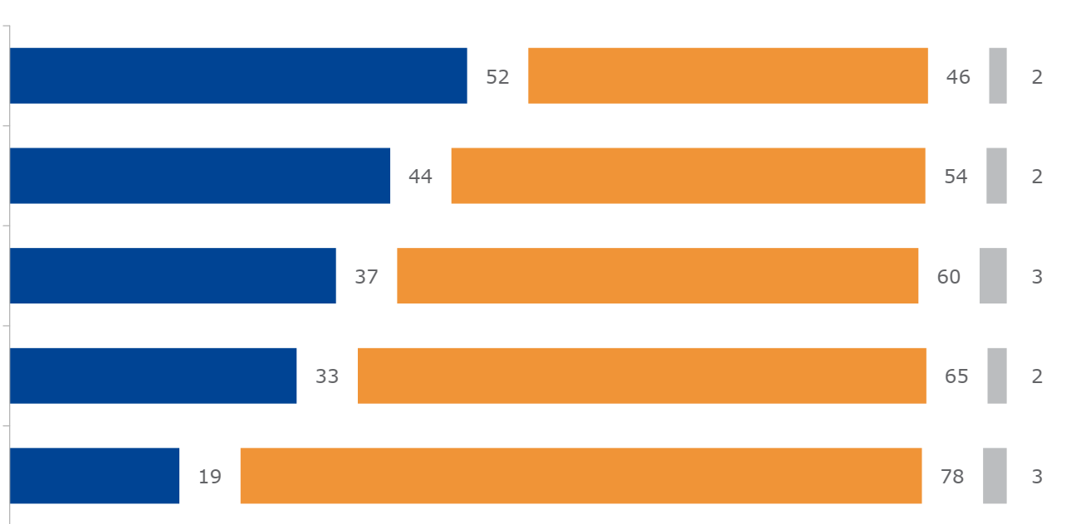
Facts and figures – use of digital technologies
EU-OSHA, OSH Pulse 2022
Would you say that the use of digital technologies in your workplace… ?
Yes
No
Don’t know
Determine the speed or pace of your work
Results in you working alone
Increase surveillance of you at work
Increase your workload
Reduce your autonomy at work
Base: all respondents, EU27 (n=25 683)
Notes:
Source: EU-OSHA, ‘OSH Pulse – Occupational safety and health in post-pandemic workplaces’, 2022 (https://osha.europa.eu/en/facts-and-figures/osh-pulse-occupational-safety-and-health-post-pandemic-workplaces).
EU-OSHA commissioned the ‘Flash Eurobarometer – OSH Pulse’ survey with the aim of gaining insights into the state of occupational safety and health (OSH) in post-pandemic workplaces.
A representative sample of more than 27,000 employed workers were interviewed in April and May 2022 in all EU countries, plus Iceland and Norway. They were asked about the mental and physical health stresses they face and the importance of OSH measures in their workplace.
The survey also asked about the work-related use of digital technologies and its impact on workers’ wellbeing.

Slide 7
Facts and figures – home-based telework
EU-OSHA, OSH Pulse 2022
17% of workers worked mostly from home in 2022
90% of them using laptops, tablets, smartphones
Home-based remote workers are less likely to report a lack of autonomy, or influence over the work pace or work processes (14.4%) when compared to the total of workers
EU-OSHA, ESENER 2019
  12% of EU workplaces in 2019 allowed employees to work from home using digital technologies
  75% of EU workplaces carry out risk assessment on regular basis but only 31% of those allowing home-based telework cover also homes
Notes:
Source: EU-OSHA, ‘OSH Pulse – Occupational safety and health in post-pandemic workplaces’, 2022 (https://osha.europa.eu/en/facts-and-figures/osh-pulse-occupational-safety-and-health-post-pandemic-workplaces).
Source: EU-OSHA, ‘Third European Survey of Enterprises on New and Emerging Risks’ (ESENER 3), 2019. Available at: https://osha.europa.eu/en/publications/home-based-teleworking-and-preventive-occupational-safety-and-health-measures-european-workplaces-evidence-esener-3

Slide 8
Facts and figures – Psychosocial risks
EU-OSHA, ESENER 2019
Psychosocial risks most commonly associated with digital technologies:
time pressure
long/irregular working hours
poor communication/cooperation
job insecurity
Notes:
Source: EU-OSHA, ‘Third European Survey of Enterprises on New and Emerging Risks (ESENER 3), 2019. Available at: https://osha.europa.eu/en/publications/third-european-survey-enterprises-new-and-emerging-risks-esener-3/view

Slide 9
Facts and figures – psychosocial risks
EU-OSHA, ESENER 2019
Workplaces reporting psychosocial risks by presence of digital technology, EU27
Personal computers at fixed workplaces | Not present
 | Present
Laptops, tablets, smartphones or other mobile computer devices | Not present
 | Present
Robots interacting with workers | Not present
 | Present
Machines, systems or computers determining the content or pace of work | Not present
 | Present
Machines, systems or computers monitoring workers’ performance | Not present
 | Present
Wearable devices | Not present
 | Present
Notes:
Source: EU-OSHA, ‘Third European Survey of Enterprises on New and Emerging Risks’ (ESENER 3), 2019. Available at: https://osha.europa.eu/en/publications/home-based-teleworking-and-preventive-occupational-safety-and-health-measures-european-workplaces-evidence-esener-3
Weighted data (weight: estex)

Slide 10
Campaign objectives
The campaign aims to:
Increase knowledge about the safe and productive use of digital technologies across all sectors
Raise awareness of digitalisation and its OSH implications
Inform about emerging risks and opportunities
Promote risk assessment and the healthy and safe management of digital transformation of work
Facilitate the exchange of information and good practices

Slide 11




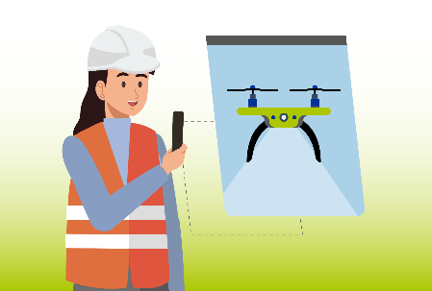

Priority areas
Digital platform work
Automation of tasks
Remote and hybrid work
Worker management through AI
Smart digital systems
Notes:
The ‘Safe and Healthy Work in the Digital Age’ campaign is organised into five priority areas that are being promoted via special communication and promotion packs spread over the full duration of the campaign. Each area looks at a specific topic related to OSH and digitalisation. A range of materials, including reports, info sheets, infographics and case studies, are being released every three to four months to maintain the campaign’s momentum.
Another priority of the 2023-25 campaign is to consider the impact of digitalisation on workforce diversity and on groups of vulnerable workers and the gender dimension. It will also focus on personnel employed under flexible working arrangements, away from the employer’s premises, ‘around’ or visiting clients, in decentralised premises (e.g., remote workers, platform workers).
Digital platform work: paid work provided through, on, or mediated by an online platform
Automation of tasks: AI-based systems, either embodied (robotics) or non-embodied (smart applications) that are enabled to perform – with some degree of autonomy – either physical or cognitive tasks and to achieve specific goals
Remote and hybrid work: any type of working arrangement involving the use of digital technologies (e.g., personal computers, smartphones, laptops, software packages, Internet) to work from home or - more generally - away from the employer’s premises or in a fixed location.
Worker management through AI: management systems and tools that collect real-time data about workers’ behaviours from various sources with the purpose of informing management and supporting automated or semi-automated decisions based on algorithms or more advanced forms of AI
Smart digital systems: intelligent applications using AI, portable equipment, high-speed wireless networks, in combination with sensor technologies (e.g., wearables)

Slide 12

Priority areas – Digital platform work
“Digital platform work frequently involves jobs in occupations and sectors that are at high risk and associated with poorer working conditions.”
An online facility or marketplace operating on digital technologies (including the use of mobile apps) that are owned and/or operated by an undertaking, facilitating the matching between the demand for and supply of labour provided by a platform worker.
DEFINITION

Slide 13
Priority areas – Digital platform work
OPPORTUNITIES
Worker autonomy
Flexible working hours
Improved access to the labour market for disadvantaged workers
RISKS AND CHALLENGES
Professional isolation
Long/irregular working hours
Algorithmic management
Digital monitoring/surveillance
Limited OSH regulations

Slide 14

Priority areas – Automation of tasks
“Using digital technologies for automation processes comes with a number of opportunities, but also potential risks and challenges, such as the loss of human situation awareness, over-reliance, or possible loss of specific skills of workers.”
Use of systems or technical procedures to allow a device or system to execute (partially or fully) a function that was previously, or conceivably could be, carried out (partially or fully) by a human.
DEFINITION

Slide 15
Priority areas – Automation of tasks
OPPORTUNITIES
Automation of high-risk or repetitive work tasks
Increased time for worker learning/creativity
Reduced exposure to hazardous environments
RISKS AND CHALLENGES
Loss of human situation awareness
Over-reliance
Possible loss of specific skills of workers

Slide 16

Priority areas – Remote and hybrid work
“Remote work must be included in the employer’s mandatory risk assessment.”
Remote work can be defined as any type of working arrangement involving the use of digital technologies (e.g. personal computers, smartphones, laptops, software packages and the Internet) to work from home or, more generally, away from the employer’s premises for most or part of the working time. The combination of remote work with work at the employer’s premises is also referred to as hybrid work. Telework is a common way to define home-based remote work.
DEFINITION

Slide 17
Priority areas – Remote and hybrid work
OPPORTUNITIES
Increased autonomy and flexibility
Better work-life balance
Improved motivation and productivity
Reduced commute time
Safety from high-risk environments
RISKS AND CHALLENGES
Isolation and lone working
Work intensification
Long/irregular working hours
Conflicts between private and working life
Inadequate equipment

Slide 18

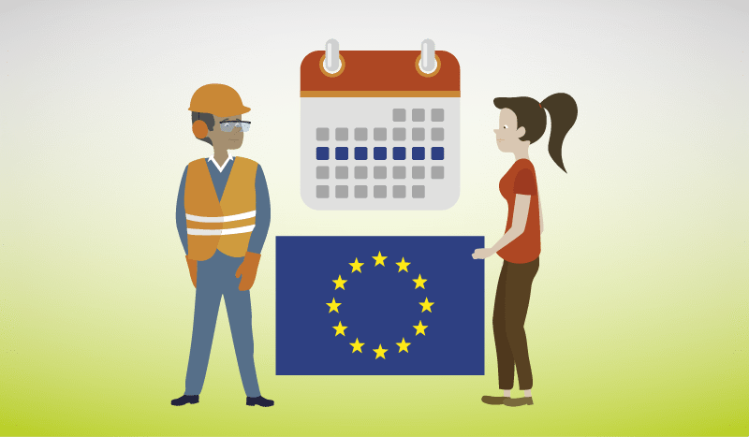
Priority areas – Worker management through AI
“It is essential to build trust in these systems by informing, consulting and allowing workers to participate in their design and implementation.”
Refers to a worker management system that gathers data, often in real time, on the workspace, workers and the work they do, which is then fed into an AI-based model that makes automated or semi-automated decisions or provides information for decision-makers on worker management-related questions.
DEFINITION

Slide 19
Priority areas – Worker management through AI
OPPORTUNITIES
Improved scheduling and task allocation
Optimised work organisation
Information to identify OSH issues
RISKS AND CHALLENGES
Reduced worker autonomy and control
Increased pressure to work faster
Invasion of privacy

Slide 20

Priority areas – Smart digital systems
“These new systems use digital technologies to collect and analyse data or signals in order to identify and assess OSH risks, thereby preventing or minimising harm and promoting OSH.”
Digital systems for monitoring and enhancing workers’ safety and health including smart Personal Protective Equipment (PPE) - that can identify levels of gases, toxins, noise levels and high-risk temperatures, wearables - able to interact with workers, with sensors that may be embedded in hardhats or safety glasses, mobile or static systems that use cameras and sensors - e.g. drones that effectively reach and monitor dangerous areas of work sites avoiding to put humans in danger in the construction and the mining industries.
DEFINITION

Slide 21
Priority areas – Smart digital systems
OPPORTUNITIES
Prevent and minimise harm to workers
Improved OSH compliance
Informed decision-making
Effective enforcement
More training opportunities in virtual environment
RISKS AND CHALLENGES
Data inaccuracies or misinterpretation
Overreliance on technology
Loss of control over work tasks

Slide 22
Risk prevention
Human-centred approach
Equal access to information of all stakeholders
Worker consultation/participation in the development, implementation and use of digital technologies and systems
Transparency about the way a digital tool operates
Holistic approach to evaluating digital technologies and systems

Slide 23
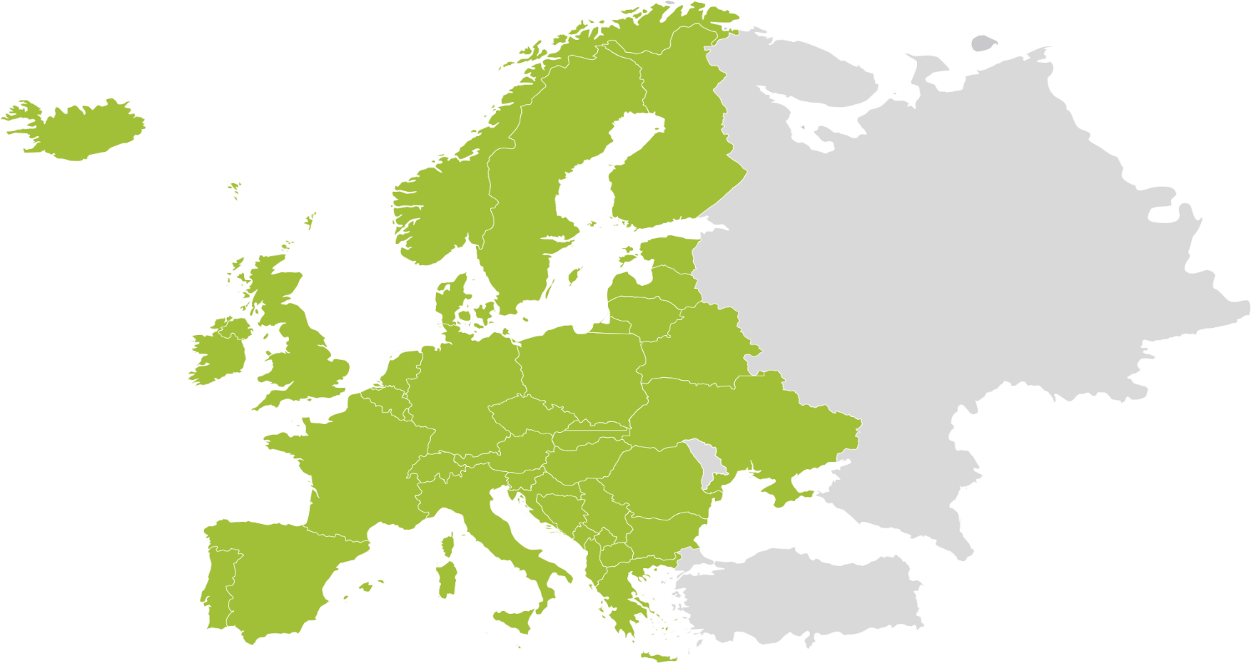


EU-OSHA and campaign partners
  ENTERPRISE EUROPE NETWORK
  EUROPEAN SOCIAL PARTNERS
  EU AGENCIES
  OFFICIAL CAMPAIGN PARTNERS
  EU INSTITUTIONS
EU-OSHA NATIONAL FOCAL POINTS
  MEDIA PARTNERS
Notes:
The campaign is run by EU-OSHA, with the help of a network of partners in more than 30 countries, including:
national focal points;
European social partners;
official campaign partners;
OSHVET partners;
media partners;
Enterprise Europe Network;
EU institutions;
other EU agencies.
The partners act as intermediaries between EU-OSHA and Europe’s workforce, disseminating campaign materials and resources at the national level. The dedication and active involvement of EU-OSHA’s partners drives the campaign and ensures that the campaign’s message is successfully promoted across Europe, reaching businesses of all sizes.

Slide 24








Campaign resources
Publications
Campaign materials
Campaign toolkit
Social media kit
Napo films
OSHwiki
Case studies
Legislation and regulations
Infographics
Notes:
Publications
A number of research reports, summaries and info sheets related to OSH and digitalisation are available and free to download. These publications can be used to inform preventive measures in the workplace.
Campaign materials
The ‘Safe and Healthy Work in the Digital Age’ campaign materials, such as the campaign guide and promotional leaflet, explain how the campaign works and how to get involved. They also clarify how the guidance provided can be implemented in the workplace.
Campaign toolkit
The campaign toolkit provides practical step-by-step advice on how to plan and run successful campaigns. It includes examples of different communication tools and offers tips on how best to use them.
Social media kit
A collection of material relevant to the campaign has been specially created to post and share through social media accounts. The resources include a selection of ready-made messages with accompanying visuals and videos.
Napo films
Several short awareness-raising films — featuring the cartoon hero Napo — have been created on the topic of digitalisation in the workplace. These are a great way to engage businesses and inform them about the campaign’s message.
OSHwiki
A section on the OSHwiki platform has been dedicated to OSH and digitalisation. It contains relevant articles and links to more information on the topic.
Case studies
In addition to the case studies in the database, policy case studies from EU countries and outside the EU are also available. These case studies describe success factors and the transferability of national policy initiatives.
Legislation
The employer is legally responsible for ensuring workplace safety and health. The risks deriving from digitalisation in the workplace fall within the scope of the OSH Framework Directive (Directive 89/391/EEC — the OSH Framework Directive), and some of the risks stemming from the use of digital technologies in the workplace are tackled by specific directives:
Directive 90/270/EEC — the Display Screen Equipment Directive
Directive 2009/104/EC — the Use of Work Equipment Directive
Directive 2006/42/EC — New Machinery Directive
Directive 89/654/EEC — Workplace Requirements
Directive 2003/88/EC — Working Time
Directive 2002/14/EC — Informing and Consulting Employees
A complete overview of relevant OSH legislation is available on the EU-OSHA website (https://osha.europa.eu/en/safety-and-health-legislation).
Infographics
In the digital age, infographics can be a powerful tool. They are able to express even complicated information clearly, succinctly and memorably, and they can be shared online.

Slide 25


How to get involved
European Week
Campaign partnership
Good Practice Awards
Campaign toolkit
Campaign materials
Social media kit
Events
Certificate of participation
Notes:
European Week
Our world-renowned European Week of Safety and Health at Work is held every year in October and is the highlight of the campaign calendar. You can get involved in many awareness-raising events that are organised in the EU and beyond, such as competitions, special film-screening events, social media events and conferences.
Campaign partnership
The success of the campaign depends on strong partnerships between EU-OSHA and key stakeholders. Pan-European and international organisations with a commitment to OSH can become an official campaign partner, which allows them to benefit from:
promotion at EU level and in the media;
opportunities to network and exchange;
sharing good practices with other campaign partners;
invitations to EU-OSHA events;
a welcome pack;
a partner certificate.
Good Practice Awards
As part of the campaign, the Good Practice Awards showcase innovative approaches to OSH management and recognise successful and sustainable initiatives for managing risks related to OSH and digitalisation. Organisations in EU Member States, candidate countries, potential candidate countries and European Free Trade Association (EFTA) countries are invited to submit entries on the theme of managing OSH and digitalisation in the workplace. The winners will be announced at an awards ceremony.
Campaign toolkit
You can access our campaign toolkit to help you get started with running your own campaign to raise awareness of the impact of digitalisation on OSH. The toolkit offers step-by-step guidance on the process of preparing and running a campaign and how to make the most of your resources.
Campaign materials
Everything you need to promote and make a contribution to the ‘Safe and Healthy Work in the Digital Age’ campaign is available in the campaign materials. A full range of resources are free to download, including the campaign guide, promotional leaflet and poster, and the Good Practice Awards flyer.
Social media kit
Take advantage of the social media kit – a collection of material for your social media accounts. Get started by selecting from the ready-made messages and accompanying visuals and videos.
Events
You can view upcoming events of the ‘Safe and Healthy Work in the Digital Age’ campaign. Events can be searched by country and by dates, and each event can be added to your own calendar to make sure you don’t miss out.
Certificate of participation
In return for organising events and activities or running your own campaign to support the Healthy Workplaces campaign, you will receive a certificate of participation in recognition of your efforts and contribution.

Slide 26






Join us beyond the bits and bytes!
Find out more on the campaign website:
  www.healthy-workplaces.eu
Subscribe to our campaign newsletter:
  https://healthy-workplaces.osha.europa.eu/en/healthy-workplaces-newsletter
Keep up to date with activities and events through social media:
Find out about events in your country from your national focal point:
  https://healthy-workplaces.osha.europa.eu/en/campaign-partners/national-focal-points
2023
October
CAMPAIGN LAUNCH
#EUhealthyworkplaces
Notes:
© European Agency for Safety and Health at Work, 2023
Reproduction is authorised provided the source is acknowledged.
For any use or reproduction of photos or other material that is not under the copyright of EU-OSHA, permission must be sought directly from the copyright holders.

